Slide 1

Bài 7: Java JDBC
Giảng viên: Nguyễn Thành Trung
Email: Trungnt9@topica.edu.vn
‹#›

Slide 2

Discussions
What is JDBC?
Reason for JDBC
History
Architecture of JDBC.
Types of JDBC driver available.
Steps to connect to DB.
Types of Statement.
JDBC Data Source.
‹#›

Slide 3
What is JDBC ?
JDBC is a standard interface for connecting to relational databases from Java
The JDBC Classes and Interfaces are in the java.sql package JDBC is Java API for executing SQL statements
Provides a standard API for tool/database developers Possible to write database applications using a pure Java API Easy to send SQL statements to virtually any relational database
What does JDBC do?
Establish a connection with a database
Send SQL statements
Process the results
‹#›

Slide 4
What is JDBC ?
JDBC is a standard interface for connecting to relational databases from Java
The JDBC Classes and Interfaces are in the java.sql package JDBC is Java API for executing SQL statements
Provides a standard API for tool/database developers Possible to write database applications using a pure Java API Easy to send SQL statements to virtually any relational database
What does JDBC do?
Establish a connection with a database
Send SQL statements
Process the results
‹#›

Slide 5
Reason for JDBC
Database vendors (Microsoft Access, Oracle etc.) provide proprietary (non standard) API for sending SQL to the server and receiving results from it Languages such as C/C++ can make use of these proprietary APIs directly
High performance
Can make use of non standard features of the database
All the database code needs to be rewritten if you change
database vendor or product
JDBC is a vendor independent API for accessing relational data from different database vendors in a consistent way
‹#›

Slide 6
History
JDBC 1.0 released 9/1996
Contains basic functionality to connect to database, query database, process results
JDBC classes are part of java.sql package
Comes with JDK 1.1
JDBC 2.0 released 5/1998
Comes with JDK 1.2
javax.sql contains additional functionality
Additional functionality:
Scroll in result set or move to specific row
Update database tables using Java methods instead of SQL commands
Send multiple SQL statements to the database as a batch
Use of SQL3 datatypes as column values
‹#›

Slide 7
History
JDBC 3.0 released 2/2002
Comes with Java 2, J2SE 1.4 Support for:
Connection pooling
Multiple result sets
Prepared statement pooling
Save points in transactions
‹#›

Slide 8
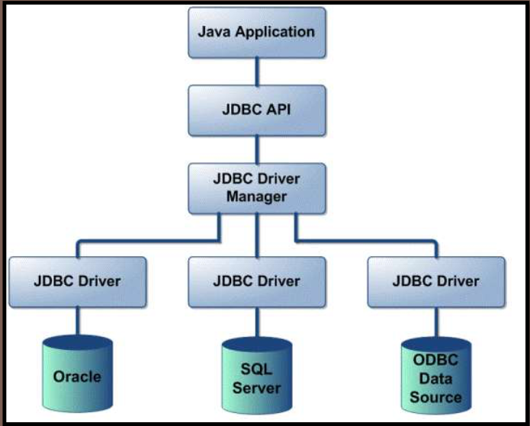
Architecture of JDBC
‹#›

Slide 9
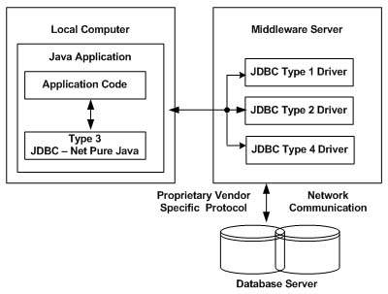
Types of JDBC driver
Type 1; jdbc-odbc bridge driver
Type 2; native API partly java driver.
Type 3; net protocols all java driver.
Type 4; native protocols all java driver.
‹#›

Slide 10
Steps to connect?
Import JDBC packages.
Load and register the JDBC driver.
Open a connection to the database.
Create a statement object to perform a query.
Execute the statement object and return a query resultset.
Process the resultset.
Close the resultset and statement objects.
Close the connection.
‹#›

Slide 11
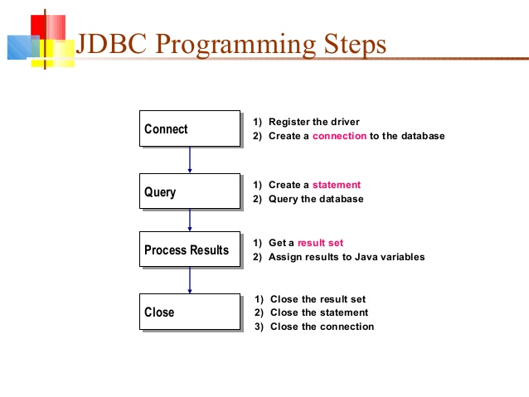
‹#›

Slide 12
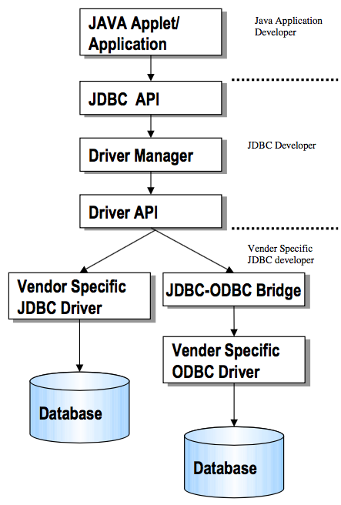
Steps to connect?
JDBC consists of two parts:
JDBC API, a purely Java-based API
JDBC driver manager
Communicates with vendor-specific drivers
Connection con = DriverManager.getConnection( "jd bc:myDriver:myDatabase", username, password);
‹#›

Slide 13
Steps to connect?
Define the connection url :
Class.forName();
For jdbc-odbc bridge driver
Class.forName(“sun.jdbc.odbc.JdbcOdbcDriver”);
For oracledriver:
Class.forName(“oracle.jdbc.driver.OracleDriver”);
For Mysql driver:
Class.forName(“com.mysql.jdbc.Driver”);
‹#›

Slide 14
Steps to connect?
Established the connection:
Connection con =DriverManager.getConnection(“url”,”user_name”,”pass”)
Create the Statement object:
Statement stmt=con.createStatement();
Execute the query:
For the SELECT query
String sql=“SELECT * FROM EMP”;
stmt.executeQuery(sql);
For the INSERT/UPDATE query
String sql=“INSERT INTO EMP VALUES(47,’TEDDY’)”;
stmt.executeUpdate(sql);
‹#›

Slide 15
Steps to connect?
JDBC returns the results of a query in a ResultSet object
ResultSet object contains all of the rows which satisfied the conditions in an SQL statement
ResultSet rs=stmt.execute Query(sql); while(rs.next()){
System.out.println(rs.getInt(id));
System.out.print(rs.getString(name));
}
Close the connection
stmt.close();
con.close();
‹#›

Slide 16
Types of Statement available
There are three types of Statement available in Statement class:
Statement
PreparedStatement
CallableStatement
Statement: This represent a simple sql/mysql statement.
Statement stmt=con.createStatement();
‹#›

Slide 17
Types of Statement available
PreparedStatement : this represent precompiled sql/my sql statement which allows improved performance. It allows to execute the query multiple times and we can set the values according to our need.
PreparedStatement psmt=con.prepareStatement();
CallableStatement: This allows the access of stored procedures; that are stored on the database
CallableStatement csmt=con.prepareCall();
‹#›

Slide 18
JDBC Data Source
The JDBC data source interface is an alternative to DriverManager class and conventional JBDC url. All the database information is present in the Naming service and retrieved using the JNDI API.
The Data Source object contains the connection information which will make the actual connection and execute the JDBC commands.
‹#›

Slide 19
JDBC Data Source
Each Data Source is assigned a logical name by conventional beginning with jdbc/ .
Advantages:
Makes the code portable and reuse.
The application does not have to remember the hardcore driver information.
Connection pooling and distributed transaction advantages is facilitate.
Syntax:
Context ctx=new InitialContext();
DataSource ds=(DataSource)ctx.lookup(“jdbc/teddyDB”);
Connection con=ds.getConnection(“user_name”,”pass”);
‹#›

Slide 20

‹#›

